Slide 1
Do This in Remembrance of Me
Let’s Worship The Lord
We are here tonight
to remember
the death the Lord died for us

Slide 2
Apostle's Creed
I believe in God, the Father Almighty,
Creator of heaven and earth.
I believe in Jesus Christ, his only Son, our Lord,
Who was conceived by the Holy Spirit,
Born of the Virgin Mary,
Suffered under Pontius Pilate
Was crucified, dead and was buried;
He descended into Hell.

Slide 3
Apostle's Creed
On the third day he rose again from the dead,
He ascended into heaven,
He is seated at the right hand of the Father,
And he will come to judge the living and the dead.

Slide 4
Apostle's Creed
I believe in the Holy Spirit,
The holy universal Church,
The communion of saints,
The forgiveness of sins,
The resurrection of the body,
And the life everlasting. Amen.

Slide 5
Do This in Remembrance of Me
1 Corinthians 11:23-28
We are always to remember
the death the Lord died for us
until He comes again.

Slide 6
Do This in Remembrance of Me

Slide 7
Do This in Remembrance of Me

Slide 8
Do This in Remembrance of Me

Slide 9
Do This in Remembrance of Me

Slide 10
Do This in Remembrance of Me

Slide 11
Do This in Remembrance of Me

Slide 12
Do This in Remembrance of Me
Jesus really did die on the cross.
Any other view appears to be at odds with modern medical science.

Slide 13
Do This in Remembrance of Me
Jesus really did die on the cross
to give us eternal life.
John 3:16 - For God so loved the world that he gave his one and only Son, that whoever believes in him shall not perish but have eternal life.

Slide 14
Do This in Remembrance of Me
Jesus really did die on the cross
to give us eternal life.
Romans 6:23 – For the wages of sin is death, but the gift of God is eternal life in Christ Jesus our Lord.

Slide 15
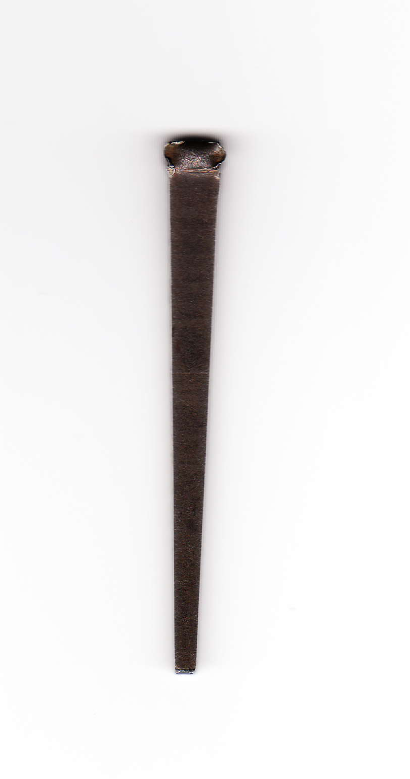
Please take a Nail and
let it remind you that:
1. Jesus died for our sins and the sins of the whole world.
2. Anyone can believe in Jesus and be saved.
3. Everyone needs to hear this message.

Slide 16
Do This in Remembrance of Me

